Slide 1


Development and Prospective Role of the EU Dairy Chain in the Global Market after Ending of Quotas
DAIRY FORUM, ANKARA, 20 MAYIS 2014
Erhard Richarts, ife Institut Kiel 20. Mai, 2014

Slide 2
Content
The EU dairy market: A decade of change from support policy to market orientation
Prospective development of world milk market and the role of EU

Slide 3
Key Figures of the EU Milk Market 2012

Slide 4
EU Exports of major Dairy Products, 1.000 t.

Slide 5
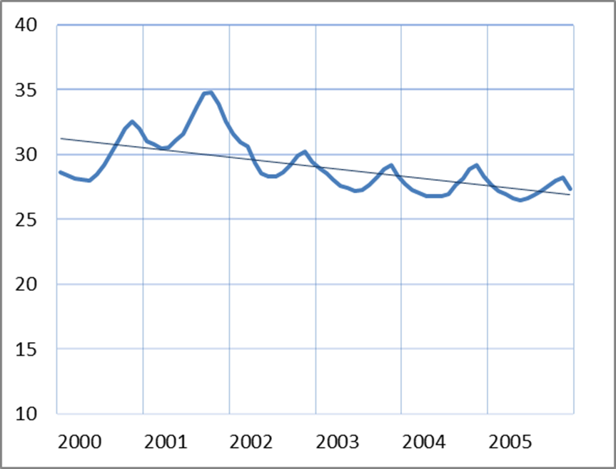
Germany: Milk Price Evolution until 2005
Downward Trend despite almost stable volumes!
Clear seasonal and modest cyclical variations.
€/100kg

Slide 6
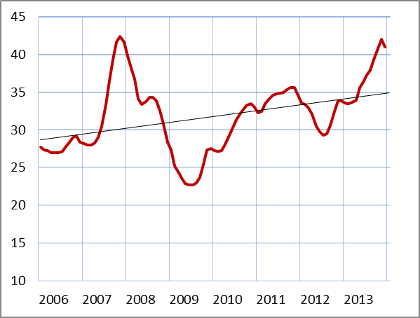
Germany: Milk Prices 2006 -2013
Seasonal fluctuations overlayed by cyclical variations
Upward trend despite growing milk production and withdrawal of political market support
37,5 Ct/kg on average in 2013 are historical record

Slide 7
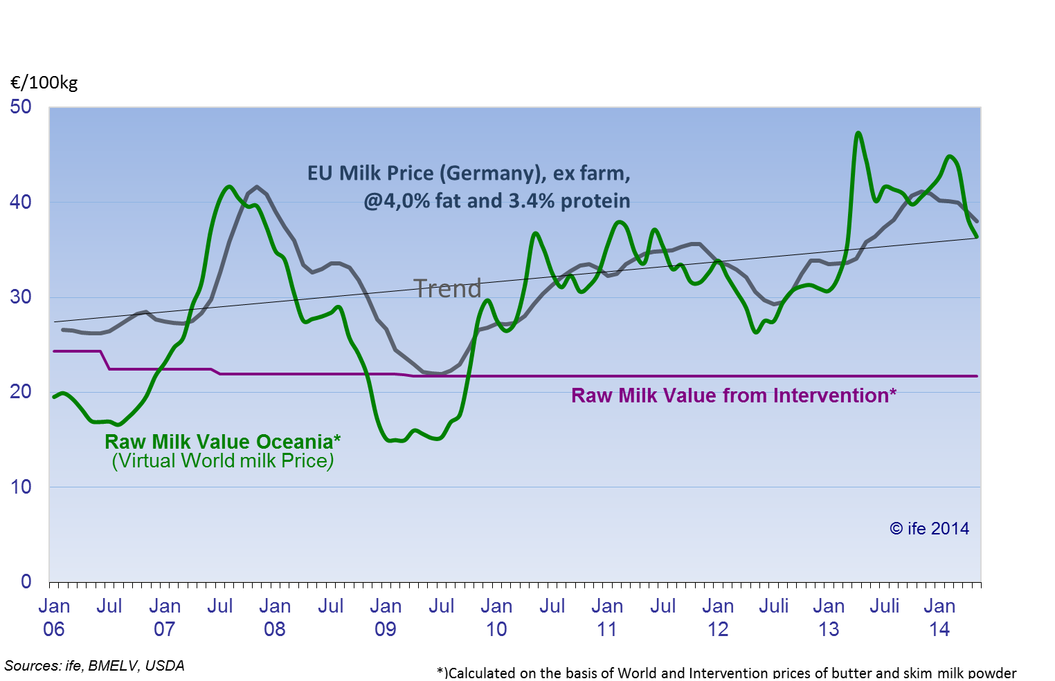
EU reforms since 2004 have prepared EU dairy industry to compete on the world market without any subsidies for exports

Slide 9
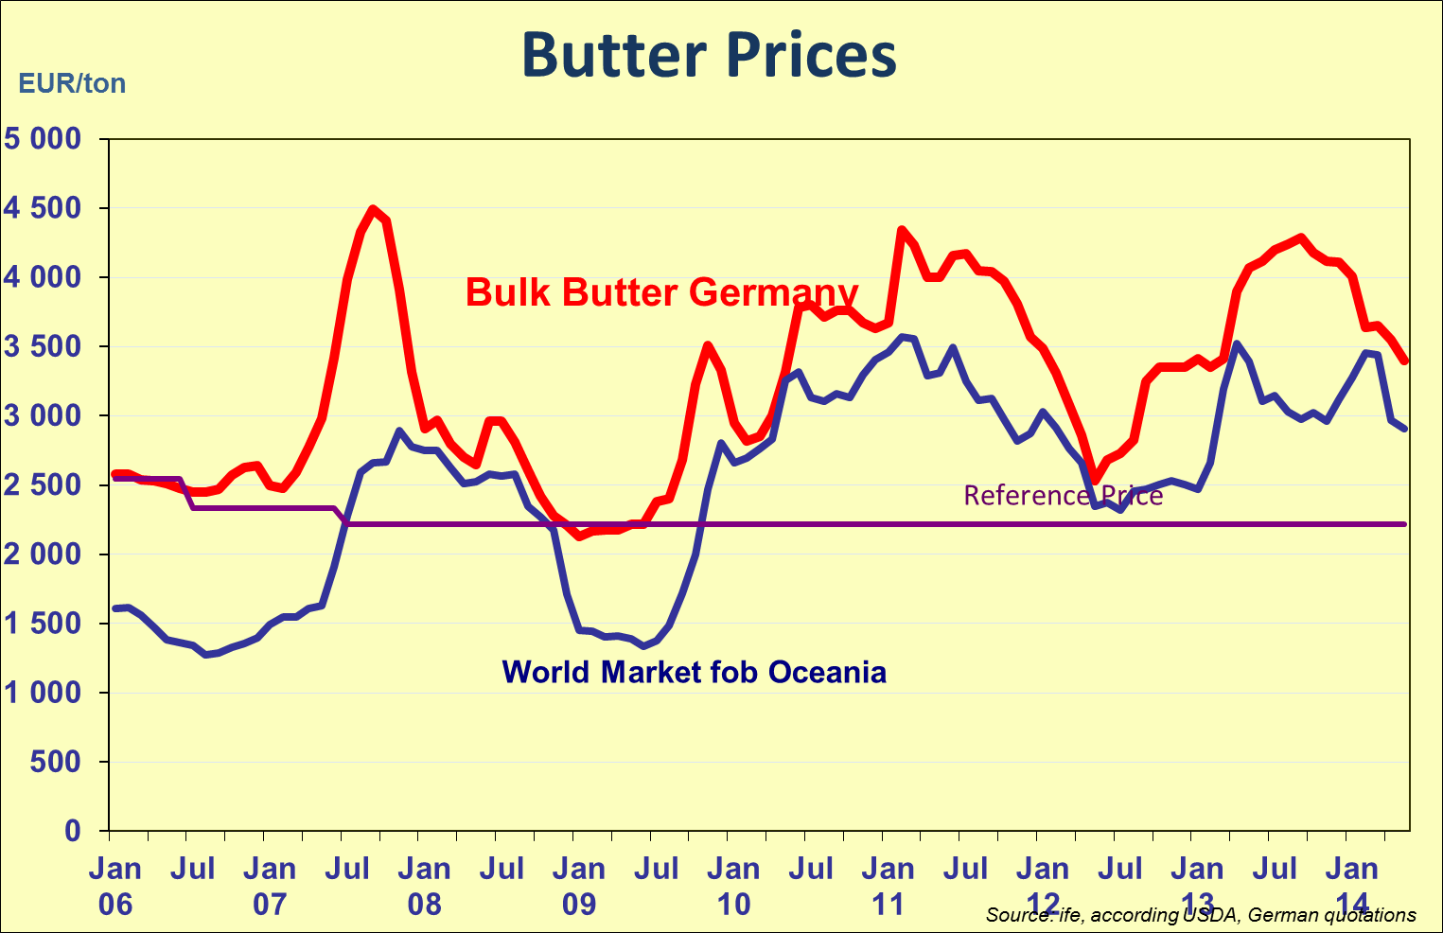
EU and international butter prices moving closer to each other!

Slide 10
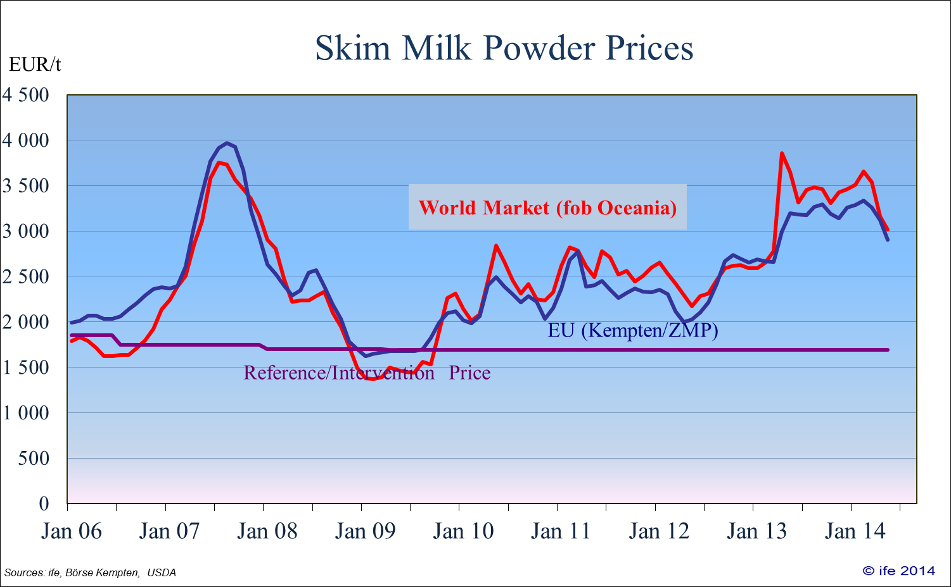
EU and international SMP prices already close to each other since 2006

Slide 11
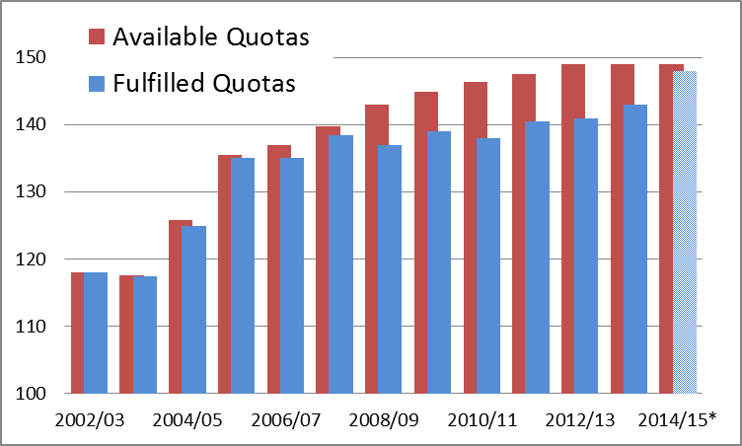
Quotas and Milk Deliveries: Preparation for „Soft Landing“
*)Fulfilment estimated

Slide 12
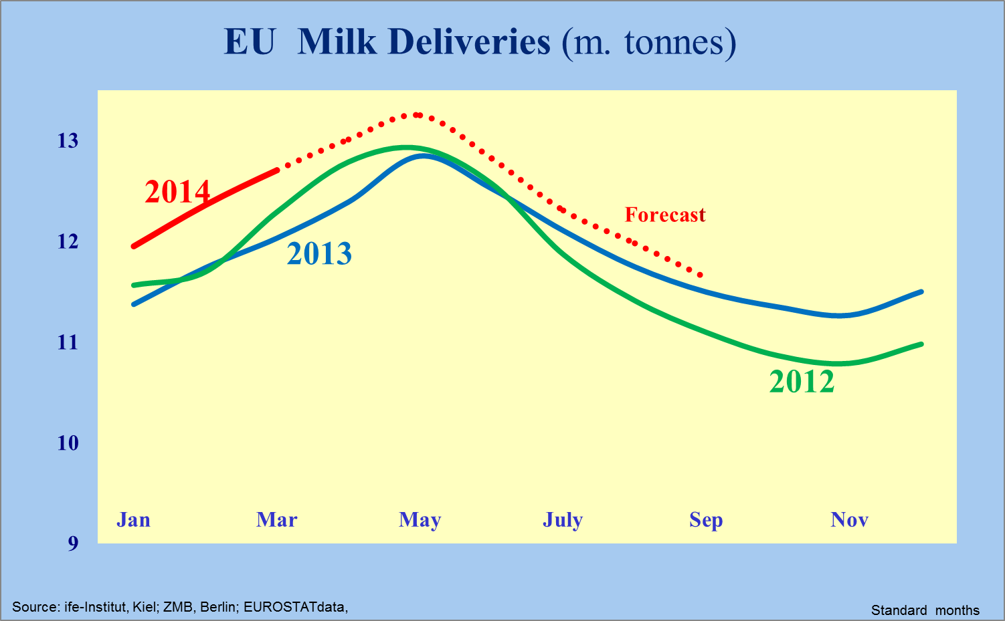

Slide 13
Markets 2014/15
Domestic demand in EU only slowly growing
EU and World production growing faster
The first time since two years growing production might keep pace with demand.
Prices are likely to stay at the recently reduced levels
Stocks might recover to what is rehgarded as to be „normal“ after they had been run

Slide 14
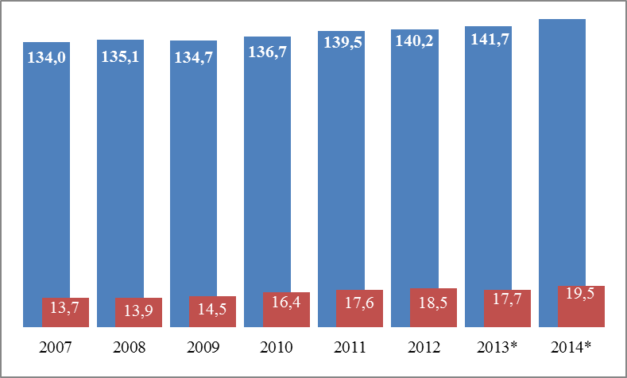
Milk Deliveries to EU Dairies and Exports beyond EU Borders, in m. t
146
Exports in milk equivalent calculated according solids content

Slide 15
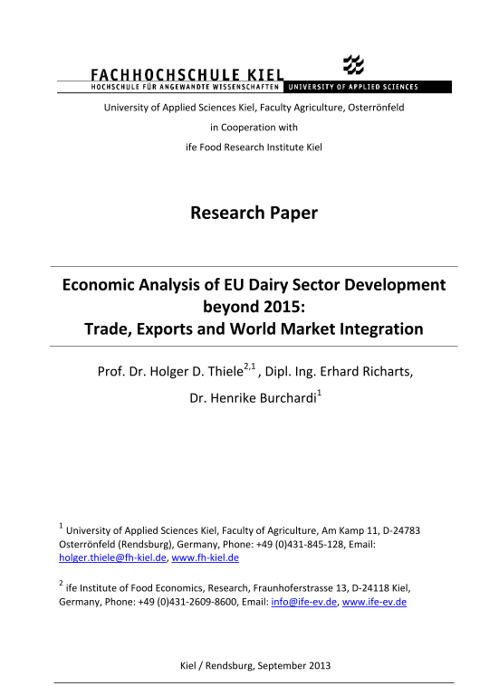
Research projects in the ife Institute
Study: Economic analysis of EU dairy sector development beyond 2015
This study is a contract work for the EDA (European Dairy Association) and has been finished in September 2013.
Presentation of the results: 26.09.2013 at the EDA Conference in Cologne.
The study “Impact of the world milk market on European milk markets and prices” analyses the production, consumption, trade and price developments and trends from 1990 to 2025 on the world market, on the EU market and in selected countries/regions.

Slide 16
EU-Dairy Market 2011 – 2022: The potential of the domestic market plus exports might grow faster than supplies, which will result in price increases

Slide 17
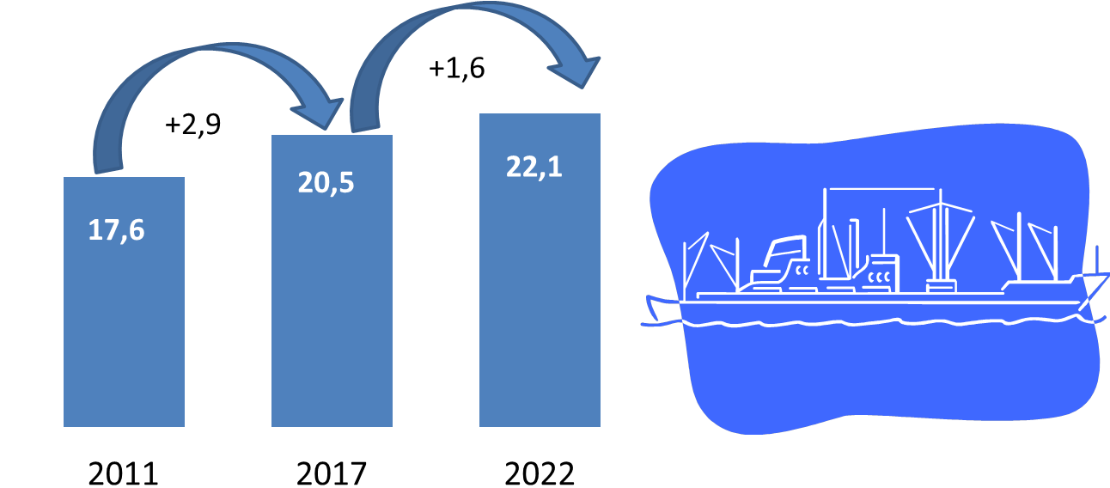
EU: Prospective evolution of milk volumes available for exports available volumes, m. t.

Slide 18
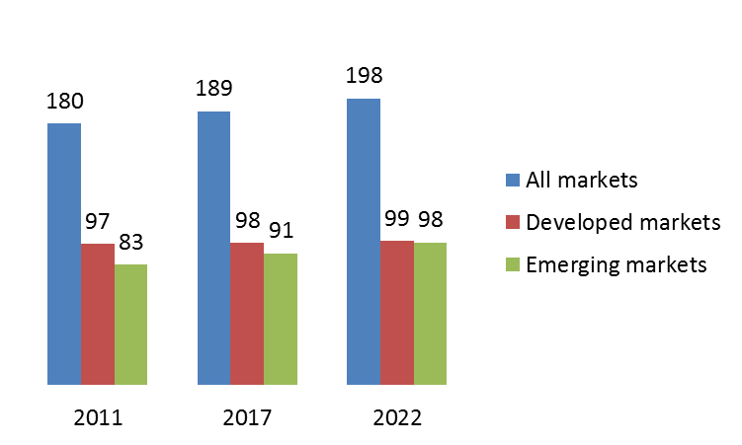
Worldwide demand for liquid products, m. t

Slide 19
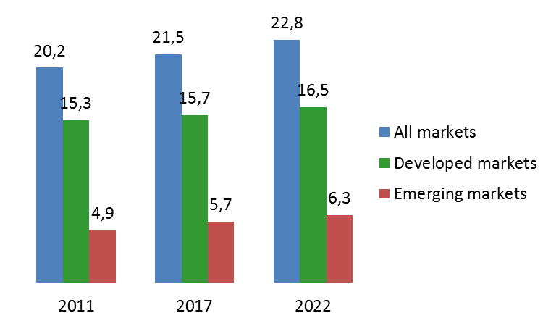

Demand for industrially produced Cheese, m. t.

Slide 20
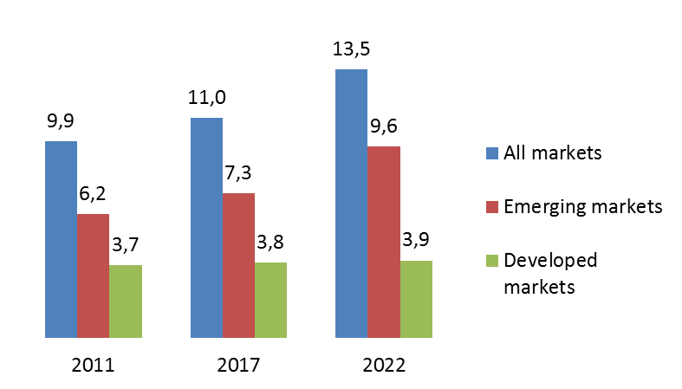

Demand for Butter, AMF, Ghee, m. t.

Slide 21
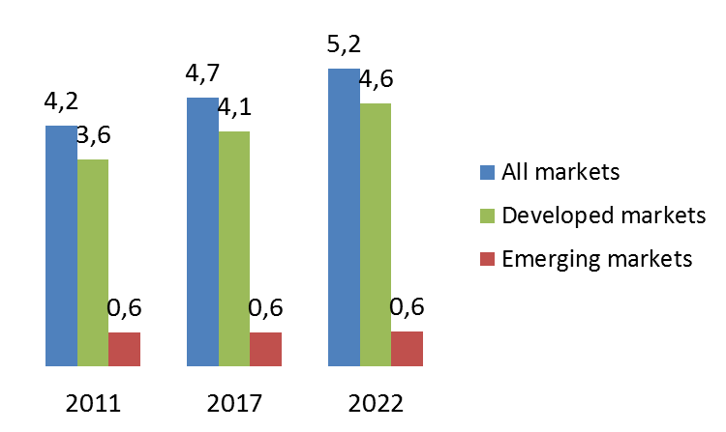
Demand for WMP, m. t.

Slide 22
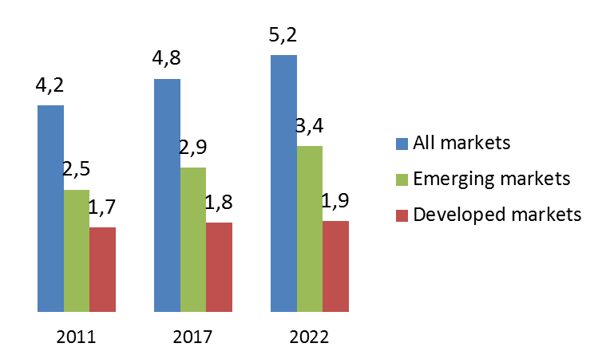
Demand for SMP, m. t.

Slide 23
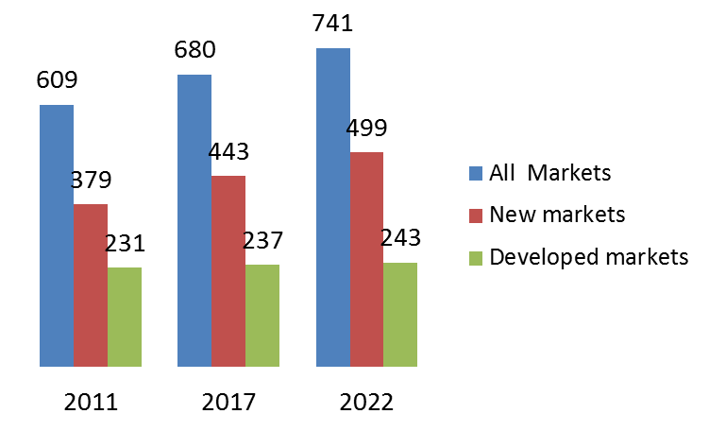
A conservative estimate: World demand for dairy products in milk equivalents (m. t)
+61
+71

Slide 24
Where to produce all that milk?
Mainly where it is demanded, but domestic production will not be sufficient in large areas of Asia, Africa and Latin America
West and Central Europe, Poland, the Baltic States, all in EU, plus Belarus, North America, New Zealand, Argentina and Uruguay have the best potentials to increase milk production and will increase their exports very fast
If the production of New Zealand (actually 20 m. t.) has to grow to 30 m. t. and beyond, other production systems than almost pasturing have to be introduced! The cost advantage of New Zealand will decline.

Slide 25
WTO after the Bali agreement
EU has already fulfilled most requirements:
Most important is the end of export subsidies, which has already been decided.
The necessary reduction of prohibitive custom tariffs on dairy is not so relevant, since a milk production which exceeds domestic requirements does not offer much space for imports anyway.
  But that does not rule out the prospects of trade flows also from Turkey to nearby areas in Greece, Bulgaria and Cyprus.

Slide 26
Summary
EU is in a good competitive position to participate in the growth of the international markets of milk products.
EU Production in the Nortwestern and Central member countries has the potential of fast growth.
EU consumption will grow only modestly.
The medium and long term price trend in EU and international market is upward .

Slide 27

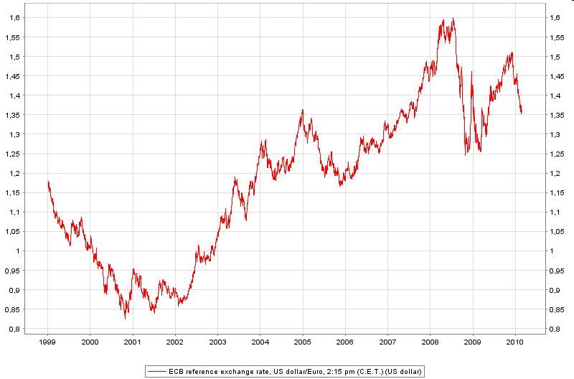

ife Institute of Food Economics
IFE Institute of Food Economics Kiel
Market analysis
Weekly/monthly dairy market analysis Europe, US, World
Process cost analysis of dairy industry
Market information
Calculation of forecast indicators
Weekly evaluation of dairy spot markets
Consulting for dairy companies
Consultancy for dairy and food industry
Expertise for milk and dairy contracts
Calculation of milk futures prices
Seminars on dairy markets
Qualification program board of directors / board of management
In-house seminars and trainings on dairy risk management
Optimization product portfolio
Consulting/expertise
Calculation of European dairy market indizes
Cost analysis of the dairy supply chain

Slide 28

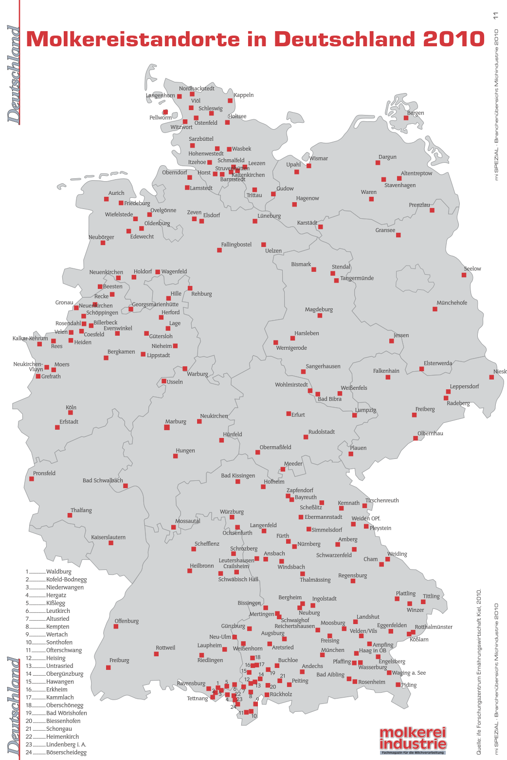
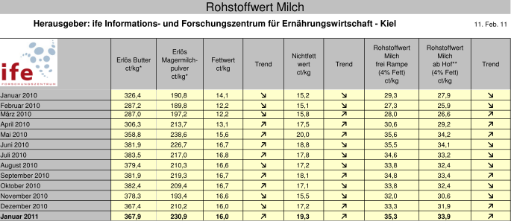
Research projects in the ife Institute
Cost-benefit analysis of school milk programme
Dairy structure analysis Germany (2014)
updated every 2 years
Cost analysis value added chain milk
Market index development: ife raw milk value Kiel

Slide 29
ife value chain cost analysis: example fresh milk

Slide 30
Thank you for your attention

