Slide 1
Threats and opportunities in milk and dairy products trade
Ankara, 20th May 2014
Béranger GUYONNET, CNIEL, France
Notes:
I’m Béranger GUYONNET and I’m working at CNIEL, which is the French dairy interbranch organisation. CNIEL is working with the Zuivel NL in the Netherlands to write the WDS, an annual survey of production, consumption, trade and prices in the dairy sector. This is the capacity in which I will present you some threats and opportunities in world milk and dairy products trade.

Slide 2
World Dairy production

Slide 3
World dairy production
(all categories included)
Geographic breakdown of world milk production in 2013 (million tonnes)
Europe 216
28%
EU-27 157
Russia 31
Ukraine 12
Belarus 7
N. America 100
13%
United States 91
Canada 8
Asia 292
38%
India 138
China 40
Pakistan 39
Turkey 17
Central America 17
2%
Mexico 11
Africa 47
6%
Sudan 8
Egypt 6
Kenya 5
S. America 67
9%
Brazil 34
Argentina 11
Colombia 7
Oceania 29
4%
New Zealand 20
Australia 9
World total: 767 million tonnes
FAO Food Outlook May 2014, IDF-DCANZ for NZ
Notes:
On this map you will see that figures of milk production are represented.
Asia is the number one milk producer, representing around 40% of the world milk production, with India representing nearly 18% of world milk production and half of Asia’s production.
Europe (total) and North America come after with 28% and 13% of world milk production, respectively.
Oceania, even if it accounts for a lot in the world balance and we will see it after, represents less than 5% of the global production.

Slide 4
Asia biggest contributor to milk output increase
Evolution of dairy production (all categories included) 2007 to 2013
North & Central America + 8 Mt
Europe + 2 Mt
Asia + 54 Mt
Africa + 7 Mt
South America + 11 Mt
World average annual growth rate
+ 2.1%
Oceania + 3 Mt
World total: + 91 million tonnes
CNIEL / IDF, FAO Food Outlook
Mt: million tonnes
Notes:
Between 2007 and 2013, world milk production grew at an annual rate of 2,1%.
Asia is by far the largest contributor, accounting for more than 60% of this growth.

Slide 5
Growth dynamics in main dairy producing countries (1/2)
CNIEL / ZMB, FAO Food Outlook
Notes:
In the USA and in the EU, cow milk’s production growth rate was smaller than the world growth rate.
On the other hand, NZ’s production is developing by 4% per year.
For the last 3 years, Turkey’s production has been booming with an annual growth rate of more than 10%

Slide 6
Growth dynamics in main dairy producing countries (2/2)
CNIEL / IDF, FAO Food Outlook, national statistics
Notes:
In Brazil and in India, the growth is basically the same at 4-5%
In China, after a big growth between 2005 and 2007, cow’s milk production was stable until last year, when it dropped due to sanitary problems for dairy cattle.
In Russia, after a growth between 2005 and 2009, the production is slightly decreasing. A drought in 2012 led to poor quality and quantity forage harvest and to a low milk production in 2013.

Slide 7
Growth dynamics in main dairy producing countries – rolling 12 month basis
NB : deliveries in Europe
CNIEL / USDA, ZMB, PZ, DCANZ, Dairy Australia
Notes:
After a decrease in early 2013, the production rebounded in late 2013 and early 2014.
The decrease in the EU was due to high feed prices and low milk prices
In NZ the decrease was due to a drought during the spring.

Slide 8
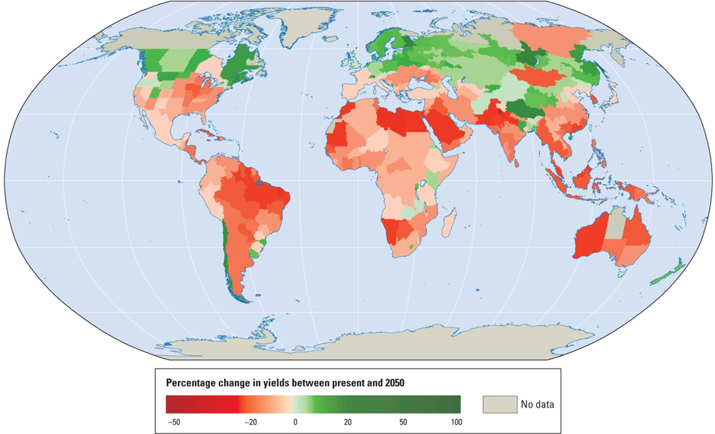
In most areas, agricultural yields may drop by 2050
Projected percentage in agricultural yields by 2050
(given current agricultural practices and crop varieties)
World Bank (World Development Report 2010)
Notes:
In most countries, a drop in agricultural yield is expected, especially in Asia, Africa and South America

Slide 9
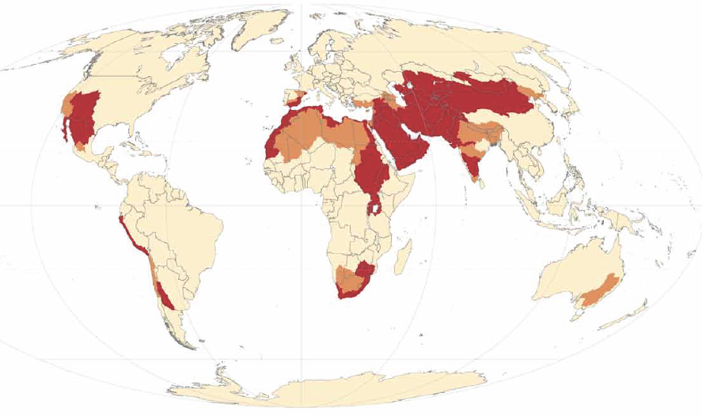

Many dairy regions face water scarcity issues
Low
Moderate
High
FAO – The State of the World's Land and Water Resources for food and agriculture, 2011
Notes:
One of the issues milk producers will have to deal with is water scarcity, especially in Asia, in North Africa and in the East of USA

Slide 10
World Dairy TRADE

Slide 11

Most emerging countries present a trade deficit for dairy products
Representation of dairy product surplus and deficit countries in 2011
Trade surplus (positive balance > 2% production)
Trade balanced
CNIEL
Trade deficit (negative balance < 2% production)
Notes:
Most countries have a trade deficit for dairy products. There are just 4 areas which supply the world market: USA, South America, Europe and Oceania

Slide 12
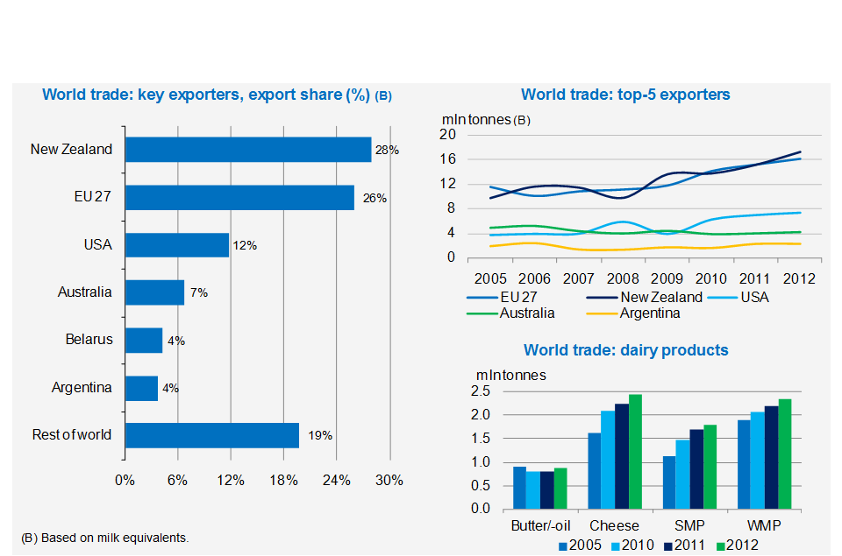
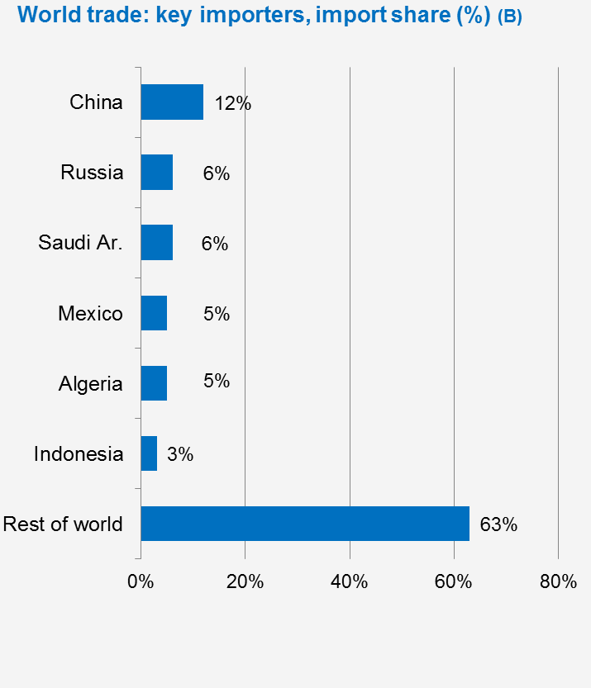
World Trade
Global trade:
53 million tonnes
7% of global production
IDF, FAO Food Outlook
Notes:
The world market represents 53 million tonnes in milk equivalent, that represents just 7% of global milk production.
As we saw before there are not many suppliers. The top 2 countries represent 54% of the world trade and the top-5 more than 75%.
On the other hand there are many more importers and China, which is by far the number one importer represent 12% of world exchange.
The top 3 exporters have developed their exports in the past years and the demand is growing for milk powder and cheese.

Slide 13
Presence on the world market
Recent export tendencies among major suppliers of the world market
EU-28
Exports | 2013 | 2 m 2014
SMP | -21% | +49%
WMP | -3% | +22%
Butter | +0% | +21%
Cheese | +3% | +0%
Whey | +5% | +7%
United States
Exports | 2013 | 3 m 2014
SMP | +25% | +26%
Cheese | +22% | +42%
New Zealand
Exports | 2013 | 3 m 2014
SMP | +0% | -25%
WMP | +2% | +13%
Butter | -3% | +41%
Cheese | +2% | -9%
Whey | -10% | -63%
Argentina
Exports | 2013 | 1 m 2014
WMP | -10% | -10%
Cheese | -6% | -3%
Australia
Exports | 2013 | 3 m 2014
SMP | -29% | +34%
WMP | -11% | +19%
Cheese | +1% | -9%
NB: Evolution of exports on a volume basis
CNIEL / USDA, Dairy Australia, Commission, ZMB, Ubifrance, national customs
Notes:
The lack of production in Europe due to high feed prices and low milk prices and in Oceania due to a drought led to a decrease in dairy product export quantities in 2013. On the other hand, USA developed its export during this period.
The rebound in milk prices and the decrease of feed prices in Europe led to an increase of production and in export

Slide 14
Demand is sustained on main markets
Recent import tendencies on substantial markets
Russia
Imports* | 2013 | 3 m 2014
Butter | +20% | +29%
Cheese | +3% | +3%
United States
Imports | 2013 | 3 m 2014
Cheese | -4% | -2%
Caseins | -4% | -4%
Japan
Imports | 2013 | 3 m 2014
Cheese | +1% | -10%
China
Imports | 2013 | 3 m 2014
SMP | +40% | +100%
WMP | +53% | +72%
Whey | +15% | -3%
Brazil
Imports | 2013 | 3 m 2014
WMP | -23% | -58%
Cheese | +14% | -30%
Algeria
Imports | 2013
SMP | +6%
WMP | -25%
*Russian imports do not account for volumes originating from Belarus
NB: Evolution of imports based on volume
CNIEL / Ubifrance, national customs
Notes:
The peak of world dairy prices in 2013 didn’t lead to a drop for milk demand and the top-2 importers demand grew last year. For the first months of 2014, the demand for the main markets is still growing.

Slide 15
World Dairy CONSUMPTION

Slide 16
Geographical variations of dairy product consumption
Apparent dairy product consumption levels in 2013 (kg per capita)
Canada
243
Russia 243
EU
286
USA
275
Japan 70
Iran
107
China 41
Algeria
147
Mexico
116
India
109
Sudan
229
Philippines 12
Brazil
178
World average: 109 kg/capita
Indonesia 13
Australia 309
Less than 50 kg
100 to 200 kg
Argentina 232
50 to 100 kg
More than 200 kg
CNIEL / IDF, FAO Food Outlook, PRB
Notes:
In most developing countries, consumption is still well below the consumption in developed countries

Slide 17
Geographical variations of dairy product consumption
Apparent per capita consumption (kg – in milk equivalent)
 | 2006 | 2012 | %
World | 101 | 108 | +7
Asia | 61 | 71 | +16
Africa | 42 | 48 | +14
Latin America | 129 | 151 | +17
Russia + Ukraine + Belarus | 253 | 255 | +1
EU + North America + Australia + New Zealand | 290 | 284 | -2
CNIEL / IDF, FAO Food Outlook, PRB
Notes:
But in these areas, the consumption is growing whereas it is stable in most developed countries

Slide 18
Dairy consumption: fast growing regions
IDF, FAO Food Outlook

Slide 19
Income and dairy consumption in the BRIC
NB : Human consumption of dairy products, butter excluded, in milk equivalent ; losses and dairy used as animal feed excluded.
CNIEL / FAOSTAT, FMI
Notes:
As we can see, the consumption of dairy products in the BRIC countries is growing thanks to the economic growth over recent years

Slide 20
Strong growth, especially in Asia
Middle class projections
Middle class : people living in households with daily per capita incomes of between USD10 and USD100 in Purchasing Power Parities (PPP) terms.
OECD
Notes:
For the coming years, the OECD is predicting a strong growth of the middle class, especially in Asia.
This is one of the reasons why a growth in dairy product demand is expected in these countries.

Slide 21
World Dairy PRICES

Slide 22
World market prices still at high levels
FOB price in Oceania US$ 1,000 / tonne up until April 2014
CNIEL / USDA
Notes:
Thanks to these figures we can see a 2 year growth of milk prices after the 2009 crisis due to a high production and a low demand (economic and financial crisis).
After this 2 year growth, dairy products prices started to decrease in 2011. The drop stopped in autumn 2012 when high feed prices and low milk prices led to a decrease in European milk production. In early 2013, a drought in NZ led to a peak for world prices.
During the last few weeks, the seasonal peak of production in Europe put pressure on world prices.

Slide 23
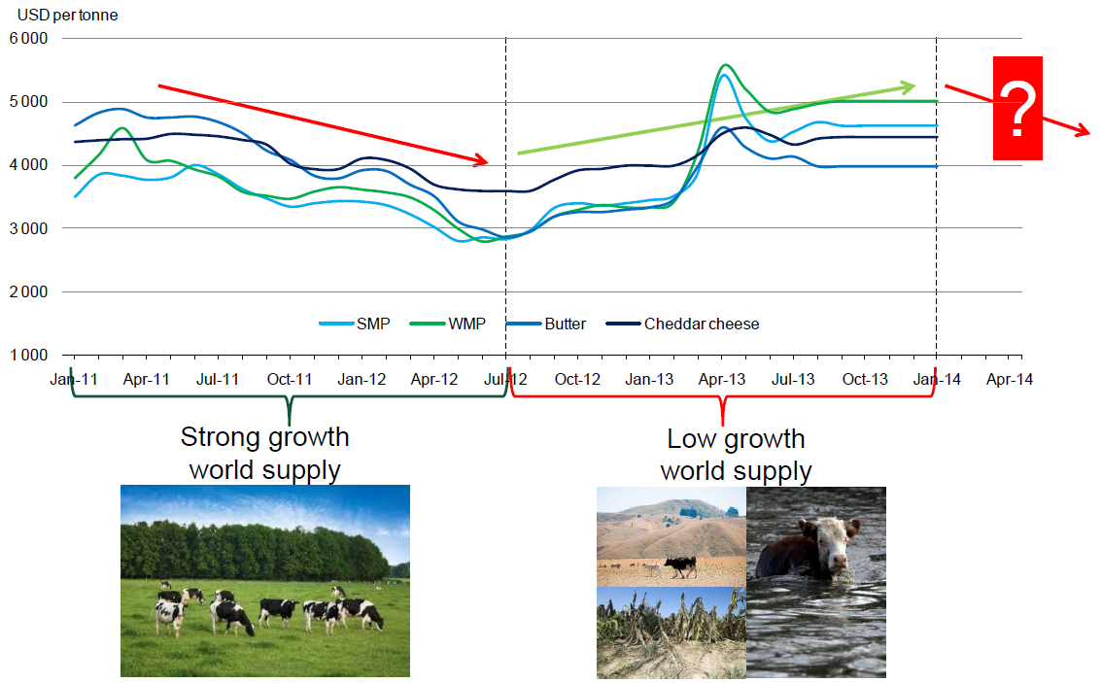
What next?
?
Notes:
It’s quite hard to predict a long term evolution for prices. Even if we saw that the world demand should stay high, there are some questions that are difficult to answer:
Is the recent decrease just due to the high seasonal peak of production in Europe?
What will be the effects of the El niño, which is expected to be a strong phenomenon this year?
Will there be other climate or sanitary issues?

Slide 24
SUMMARY
Bad weather + High input prices had led to a low start in 2013
But global dairy production is now rapidly rebounding
Dairy demand remains strong, esp. from emerging markets
Markets put under pressure and reached record levels
Next?
  Seasonal peak in Northern hemisphere
  End of quotas in Europe
  Weather & sanitary issues
  ...

Slide 25

Q&A

Slide 26


